Slide 1
Transaction Rate Alarm
Background
Transaction rate alarm system
This might indicate some kind of attack that needs to dealt with quickly, so must work in real time e.g someone might be using a stolen credit card to buy products over and over again. Might be a ddos attack or even a genuine multiple purchase
Objectives
Operational alarm system that alerts us if there is a surge in a rate of orders all of a sudden within a short time span

Slide 2
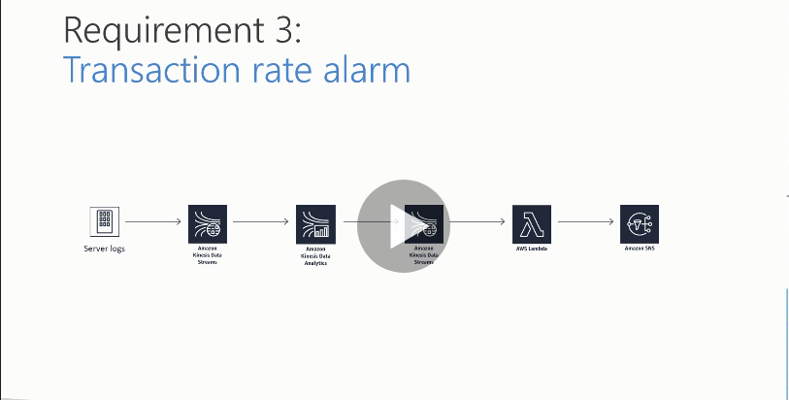
Design Solution Blueprint

Slide 3
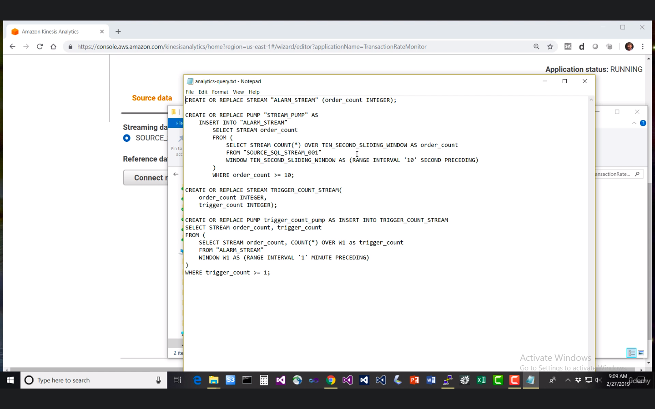
Kinesis data Analytics SQL editor script
A query script is written and put into the Kinesis data analytics Sql editor to do the analysis and fire off into another Kinesis data stream

Slide 4
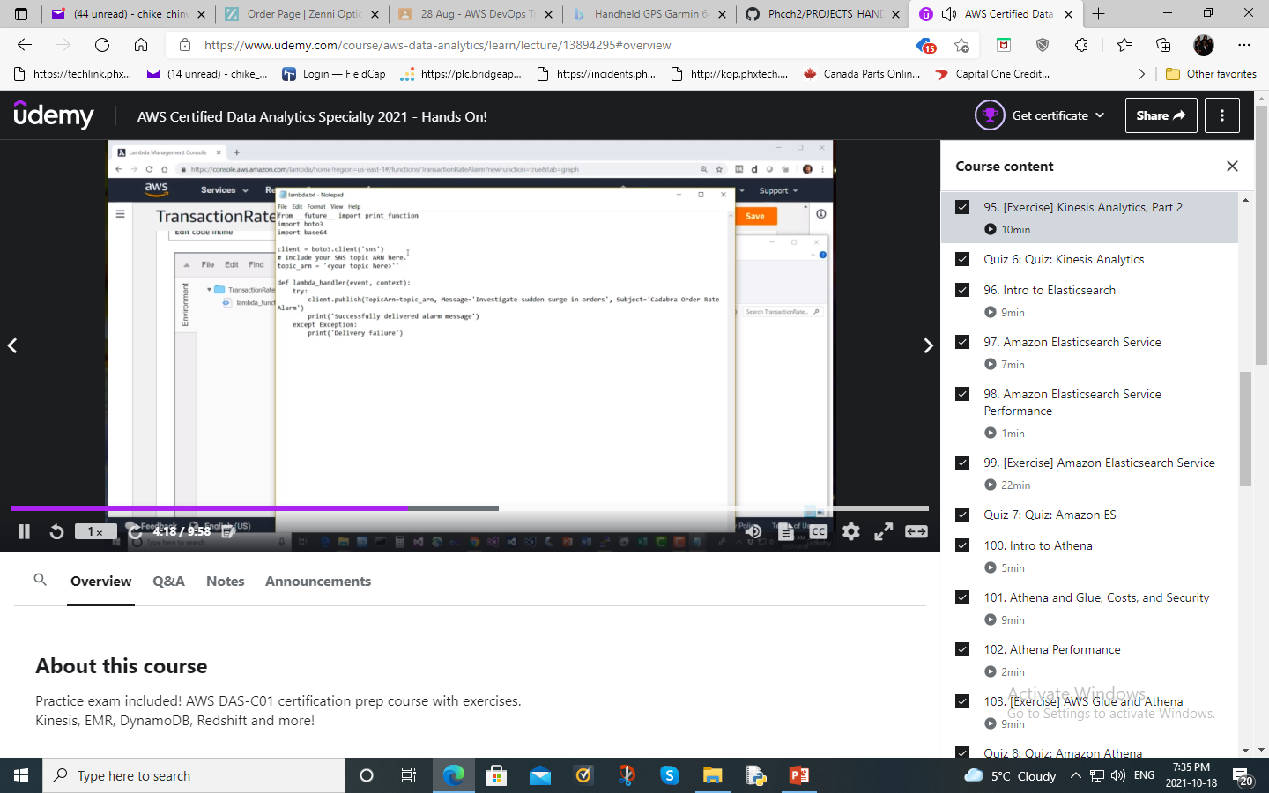
Lambda Function Transaction Alarm script
Python code (Boto 3) run time in Lambda function. Transaction Alarm script. You should add the SNS topic arn (Amazon resource name) into the script to wire up the whole architecture

Slide 5
Process
Mechanics
Simulate order data from an EC2 instance (Use CLI and configure our logs to write into the Kinesis data stream that was created)Kinesis agent in the EC2 instance pumping the data into Kinesis data streams.
Publish that data using Kinesis data streams and use Kinesis data analytics (Run time = SQL) to monitor incoming orders, this in turn does the analysis and send the analysis into another Kinesis data streams, (real time) which will in turn trigger AWS Lambda. The Kinesis data analytics might have a sliding window of 10s such that it keeps monitoring the orders in batches as they come in, and if that order exceeds a threshold set in 10s, it will fire off a trigger.
The Kinesis SQL editor will have to be populated with code that will do the analysis
Use AWS Lambda function to extract data from the destination Kinesis data streams and fire off alarms into Amazon SNS service which will fire off a text message to your cellphone when an anomalous situation is detected. The Lambda function will have a Kinesis data trigger. Create an SNS topic and add subscribers – your phone. Also add the topic arn (Amazon Resource Name)into the Lambda script.

Slide 6
Security
AWS Lambda will need IAM roles that will enable it to consume data from Kinesis data streams (AmazonLambdaKinesisExecutionRole role), (AmazonSNSFullAccess) to be able to write to SNS, CloudwatchFullAccess role to monitor the alarms and AWSLambdaBasicExecution role
Also add a Kinesis data analytics role (Default) – Should work with Kinesis data streams and Kinesis Firehose.

